Slide 1

Full moon and Crime
Dsc530 final project
Bellevue university
By Arnold m. reyna

Slide 2



Slide 3
Powerpoint Instructions:
A minimum of 5 variables in your dataset used during your analysis (for help with selecting, the author made his selection on page 6 of your book). Consider what you think could have an impact on your question – remember this is never perfect, so don’t be worried if you miss one (Chapter 1).
Describe what the 5 variables mean in the dataset (Chapter 1).
Include a histogram of each of the 5 variables – in your summary and analysis, identify any outliers and explain the reasoning for them being outliers and how you believe they should be handled (Chapter 2).
Include the other descriptive characteristics about the variables: Mean, Mode, Spread, and Tails (Chapter 2).
Using pg. 29 of your text as an example, compare two scenarios in your data using a PMF. Reminder, this isn’t comparing two variables against each other – it is the same variable, but a different scenario. Almost like a filter.
The example in the book is first babies compared to all other babies, it is still the same variable, but breaking the data out based on criteria we are exploring (Chapter 3)
Create 1 CDF with one of your variables, using page 41-44 as your guide, what does this tell you about your variable and how does it address the question you are trying to answer (Chapter 4).
Plot 1 analytical distribution and provide your analysis on how it applies to the dataset you have chosen (Chapter 5).
Create two scatter plots comparing two variables and provide your analysis on correlation and causation. Remember, covariance, Pearson’s correlation, and NonLinear Relationships should also be considered during your analysis (Chapter 7).
Conduct a test on your hypothesis using one of the methods covered in Chapter 9.
For this project, conduct a regression analysis on either one dependent and one explanatory variable, or multiple explanatory variables (Chapter 10 & 11).

Slide 4
5 variables:
Variables
Source #1: Austin Crime statistics (2014-15)
https://www.kaggle.com/jboysen/austin-crime?select=austin_crime.csv
Variable | Description | # of list of values | # of Records
timestamp- | Date/time of crime committed | 73,544 | 73,544
Description (Crime)- | Crime description | 47 | 79,214
primary type (Crime)- | Crime category | 18 | 79,214
Crime severity- | From 18 primary types, created a scales from 1-5 | 5 | 79,214
District- | City district | 54 | 84,871
Unique Key- | Crime ID | 73,544 | 73,544
Zip Code- | City zip code | 48 | 73,201
Source #2: Full Moon Calendar date - https://www.kaggle.com/lsind18/full-moon-calendar-1900-2050
Full Moon Date | Dates of every full moons since 1900 | 1868 | 1868
the main variables of my focus will be the ‘Primary type’ (Crime), Crime severity, and Full Moon Date. These variables will serve as the dependent variable, controlled by the independent, variable - 'Full Moon date’. Crimes types and severity can be used to test if full moons influence the severity of offenses.

Slide 5
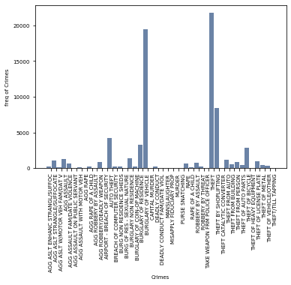
Histogram #1: Crime description
Description (Crime)- | Crime description | 47 values | 79,214 records
Summary: type is categorical. These crime descriptions indicate the type of crime committed. For analysis, will need to group into categories of crime level to compare to full moon.
High number of crimes deal with theft: Burglary of vehicle and other larcany. On the tail end are violent crimes such as aggrevated crimes and murders.

Slide 6
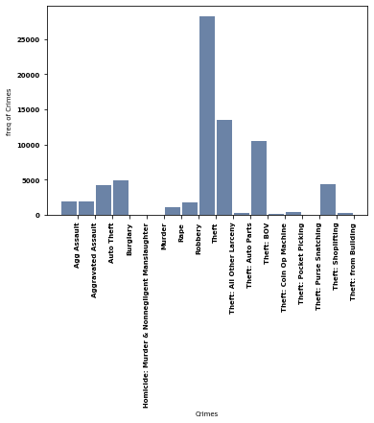
Histogram #2: Crime Types
primary type (Crime)- | Crime category | 18 | 79,214
Summary: type is categorical. These subcategories serve as how severe the crime is. For analysis, will need to convert these into a measurable scale for the exploratory analytics. This category serves as aggression level which can be used to compared to days there was a full moon.
This histogram is a grouping of the prior ‘Crime description’ variable, so follows the same peaks and tail.

Slide 7
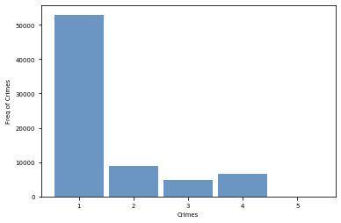
Histogram #3: Crime severity
Summary: I created this scale of severity from the 18 categories for the exploratory analytics.
Logic: stealing was deemed lowest aggression on scale: severity=1. Highest severity was murder=5. Between 2-4 were crimes based on aggressive nature ie. assault, purse snatching, etc.

Slide 8
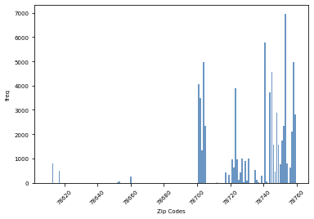
Histogram #4: Zip Code
Summary: Zip code can be used to location-based analytics. There were mainly 4 zip codes which had the highest crime. Analytics should focus on these 4 areas since they would be more sensitive to independent influences.
There are 4 main zip codes which are peak crime areas. These can show most sensitivity when analyzing sensitivity on variations during full moon days.

Slide 9
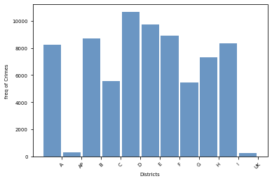
Histogram #5: District
Summary: District could serve as a different ways to distinguish crime by location. This variable didn’t serve as useful since there wasn’t a distinguished pattern.

Slide 10
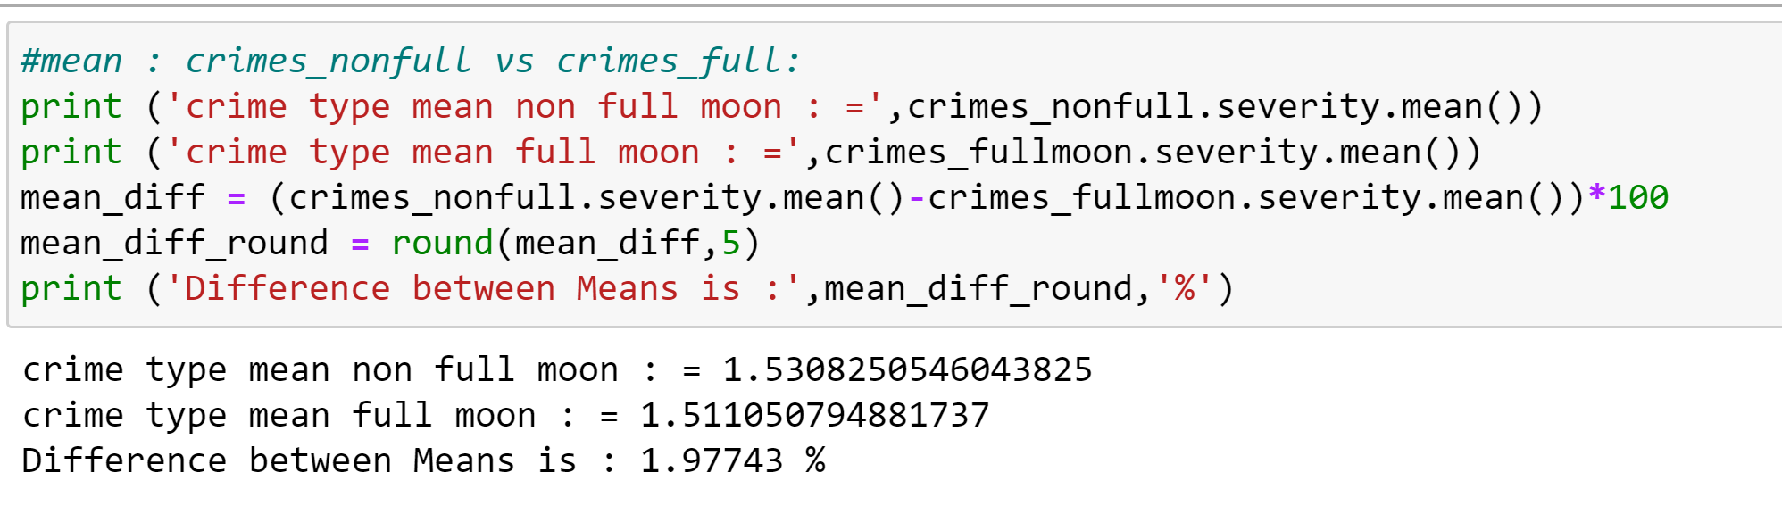
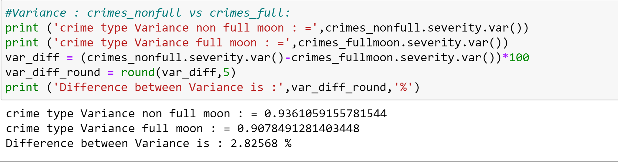
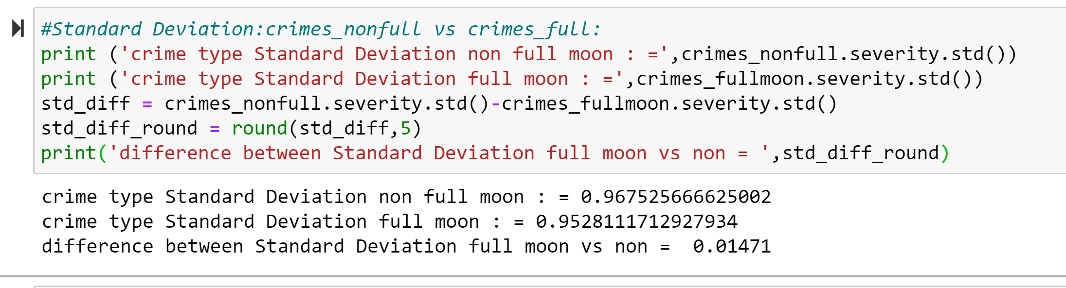
Other Descriptive characteristics:
Mean difference: A 1.98% swing of Mean indicates higher severity of crimes on Non-full moon days (scale is 1-5, severity). This decrease of 1.98% shows the opposite effect
Variance difference: This 2.83% reduction in Variance shows less swings in crime severity during Full moons.
Standard deviation difference is only 0.0147- too small to be significant. (To put that in perspective, the difference in height between men and women is about 1.7 standard deviations)

Slide 11
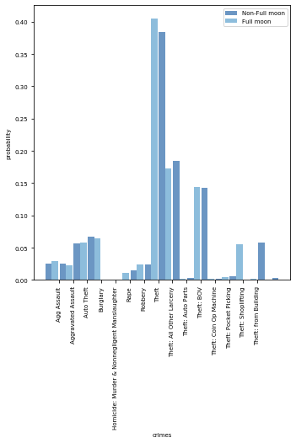
PMF Plot: Crime Full moon vs non-full moon
Summary: PMF normalizes data, giving a visual difference between crime on full moons vs non fullmoon days.
Conclusion: Robbery theft, and shoplifting do show measurable increases during full moons. Other crimes seem to show inverse or no change.

Slide 12
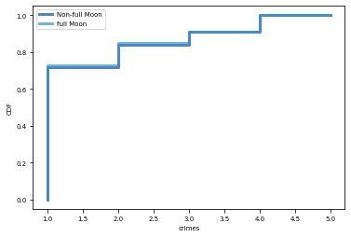
CDF: Comparing between Full moon vs non-full moon
Summary: Observation of CDF show abnormally high # of crimes in lower scale. Then levels off to a linear path from 70% up.
Close observation does show Full-moon line (light blue) slightly higher for crimes from severity scale 1-3, then tracking equally from 3-5 scale.
Conclusion: Small support to Hypothesis- crime higher on full moon days.

Slide 13
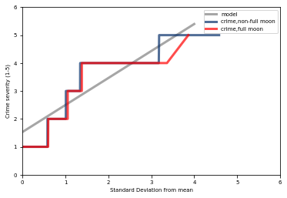
Normal Probability Plot- with normal distribution (grey)
Summary: graph showing crimes on 1)Full moon days (RED) , 2)Non-full moon days, 3) normal distribution (Grey).
Results: both crime lines seem to show higher crimes in center and lower crime at tails compared to the normal distribution. This seems to follow a narrower curve. Overall both curves follow eachother, except the high end, where the Non-full moon seems to be higher than the non-full moon.
Conclusion: This is opposite of my hypothesis that crime is higher on full moon days.

Slide 14
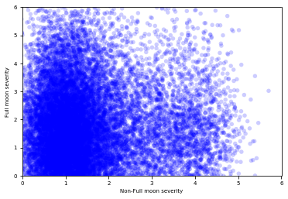
Scatter Plot: Crime severity
Summary: Simplest way to check relationship between 2 Variables. This plot shows there seems to be more higher crimes (y-axis) during Full moons vs Non-full moons (x-axis).
There is a heaver spread of 3-4 range for Full moon vs non-full moon (1-2 heavy spread).
Conclusion: This is supportive of the hypothosis.- Full moon causes more crime (severity)

Slide 15
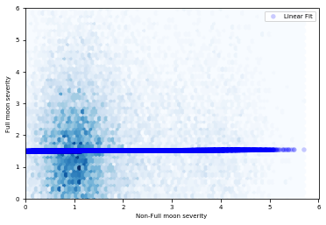
Correlation Coefficient with Scatter Plot- Chapter 10 - Linear Least Squares plot:
Summary: Correlation coefficients measure the strength and sign of a relationship, but not the slope.
There are several ways to estimate the slope; the most common is a linear least squares fit.
A “linear fit” is a line intended to model the relationship between variables.
A “least squares” fit is one that minimizes the mean squared error (MSE) between the line and the data.
Conclusion: this Linear Fit line on scatter plot shows relationship between crimes on Full Moon vs non full moon day. Linear relationship, but slope is almost zero, so very small to indicate relationship.

Slide 16
Logistic Regression Test:
Optimization terminated successfully.
Current function value: 0.151931
Iterations 7
Logit Regression Results
==============================================================================
Dep. Variable: moon No. Observations: 73544
Model: Logit Df Residuals: 73542
Method: MLE Df Model: 1
Date: Thu, 06 Aug 2020 Pseudo R-squ.: 4.707e-05
Time: 12:27:08 Log-Likelihood: -11174.
converged: True LL-Null: -11174.
Covariance Type: nonrobust LLR p-value: 0.3051
==============================================================================
coef std err z P>|z| [0.025 0.975]
------------------------------------------------------------------------------
Intercept -3.2821 0.038 -87.206 0.000 -3.356 -3.208
severity -0.0215 0.021 -1.020 0.308 -0.063 0.020
==============================================================================
Coef of 'Severity' is negative, which indicates Full moon has opposite effect, but is a very small #.
The P-value 0.3 which shows to be greater than .05, so are statistically insignificant.
The coefficient of determination, R2 value for this model is small (.000047), which means that moon doesn’t account for a substantial part of the variation. R2 does not apply to logistic regression. Since I used Full moon as a logistical attribute, this is the case here.
Conclusion: There is not statistical data to show the link between full moon and crime, based on P-value, R2, coefficient.

Slide 17
Conclusion:
After running different tests, we see some weak links between crime and the full moon mainly while visually validating data, but direct analytical tests don’t show a correlation between Full moon days and severity of crime.

